Slide 1
Assignment 3/Mini-project
Deadline: March 22, GROUP SIZE - 2 or 3
Visual Recognition

Slide 2
Assignment 3a (7 marks)
Play with CNNs
CIFAR-10 dataset
AlexNet has 5 Conv and 3 FC layers
Play with a medium deep network with atleast 2 conv and 2 FC layers.
Metrics: training time and classification performance
Compare ReLU vs tanh vs sigmoid
With and without momentum, adaptive learning rates
Finally: what would be your recommended architecture..

Slide 3
Assignment 3b (3 marks)
CNN as a feature extracter
Pick your favourite object recognition dataset, other than CIFAR/MNIST
Use Alexnet/any deep NN as a feature extracter (extract last layer as features), use any model on top and report the classification accuracies
Report accuracies for Bike vs Horses dataset also

Slide 4
Assignment 3c: YOLO V2 (2 marks)
Read YOLO V2 and V1 papers
Pick 5 additional features of YOLO V2 and document it in the report

Slide 5
Assignment 3d: Object tracker: SORT + DeepSORT (8 marks)
Record your own short videos (3 different) of Electronic City traffic
For the detections, use Faster RCNN and YOLO V2
Implement a car counter using object tracking (SORT and DeepSORT)
Document the results and observations
Document the difference between SORT and DeepSORT
Create ground truths if needed for evaluation
Not needed to implement Faster RCNN/YOLO V2/SORT/Deep SORT from scratch

Slide 6
Multi-object tracking

Slide 7
Components of MOT tracking

Slide 8
Simple Online Real Time Tracker (SORT)
Frame t
YOLO v3
Kalman Filter
Output
Hungarian
Algorithm
Frame t+1
YOLO v3
ICIP 2016: Alex Bewley, Zongyuan Ge, Lionel Ott “SIMPLE ONLINE AND REALTIME TRACKING”

Slide 9
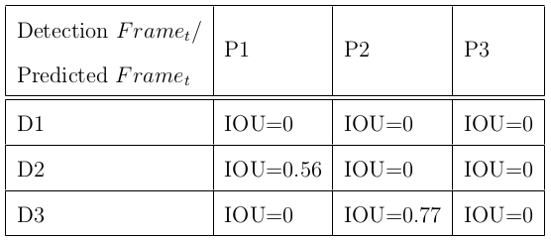
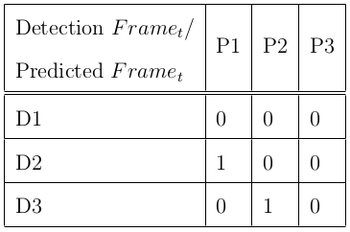
Hungarian algorithm
Hungarian Algorithm

Slide 10
Deep Simple Online Real Time Tracker (DeepSORT)
Frame t
Kalman Filter
YOLO v3
Predicted Image
Output
CNN, cosine metric
Bounding Box
Frame t+1
Detected Image
Hungarian algorithm
YOLO v3
Bounding Box
Wojke, Nicolai, and Alex Bewley. "Deep cosine metric learning for person re-identification." 2018 IEEE winter conference on applications of computer vision (WACV). IEEE, 2018.

